Slide 1


JBD Foxconn.AI 工作規劃
2022/5/16

Slide 2
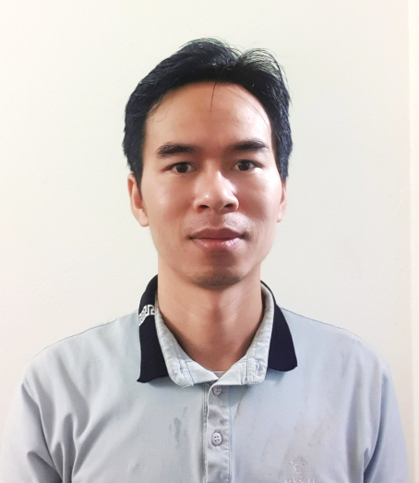




Nguyen Tuan Anh (阮俊英, James) - Introduction
Programming software system PM/MPM
Team Coaching
Orienting and researching solutions to team problems
Technical management of the entire team
Teach the team the necessary knowledge
Developing human resources and team capacity
Improving Chinese
2005
2009
2022
Q4
Q2
Q3
Understanding Industrial chain systems
Understand how Kitting works and its downsides
Understand how systems analyze failures and implement methods for improvement
Create SML system (Smart Material Location)
Programming software IVIS (Intelligent Visual Inspection System)

Slide 3
Nguyen Tuan Anh (阮俊英, James)
Personal career development roadmap
2022
Technical manager of the department
2023
Deputy Manager of Technical and Human Department
2024
Head of Technical Management and Human Resources Department

Slide 4
Nguyen Tuan Anh (阮俊英, James)
Knowledge and experience
11ys , 2005-2015
AI engineer
17ys , 2005-now
AIoT
Embedded system
5ys, 2008-2012
Industrial
Equipment enginering
7 years,
2016-now
IoT
Software
Engineering
Web Design
5years ,
2008-2012
CEO
/CTO
7 years,
2008-2012
2015-2016
Graphic Design
Lecturer
5 years, 2018-now

